Slide 1
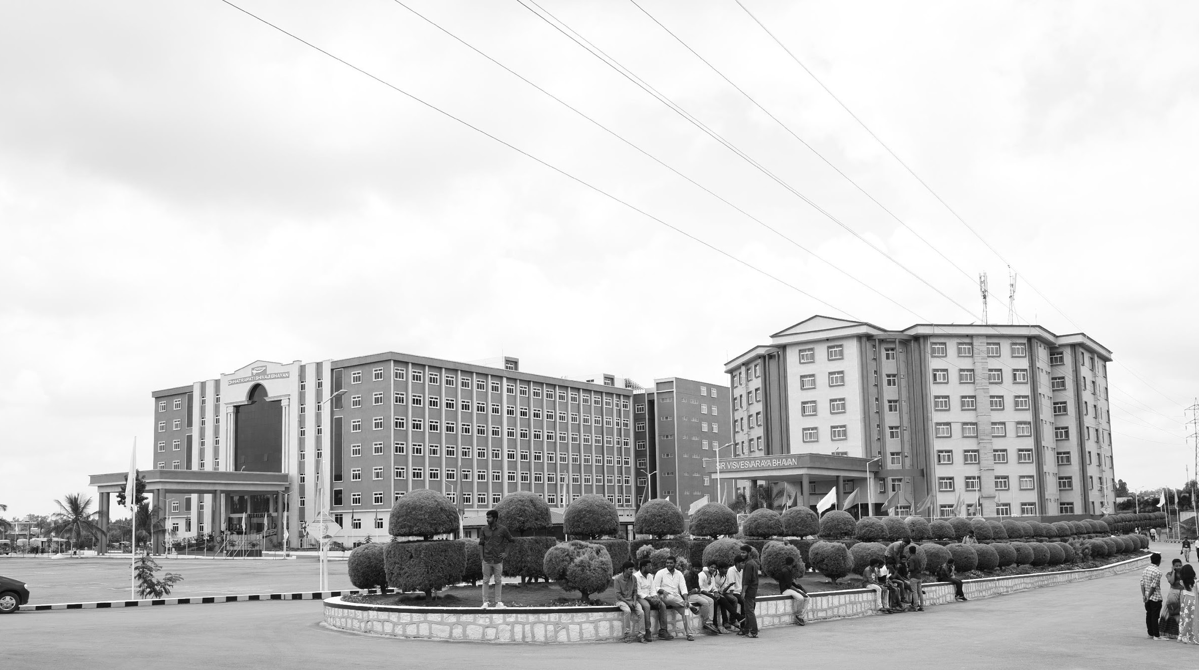
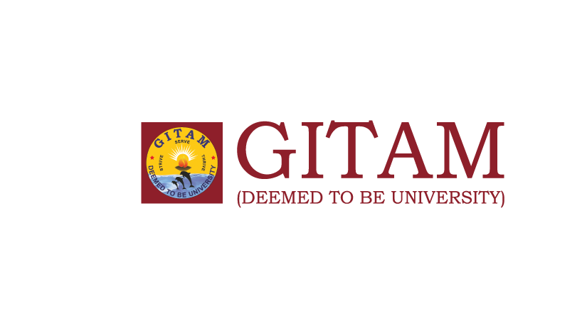
Modification on Conventional Visible and Infrared Image fusion methods for Real time Applications
AY 2021-25
GITAM UNIVERSITY
Major Project
Project ID: A5
A University should be a place of light, of liberty, and of learning.
Department of Electrical Electronics and Communication Engineering
Project Team:
N Shanmuka HarshaVardhan Reddy BU21EECE0100186
Battula Thanuja BU21EECE0100295
S MD Moinuddin BU21EECE0100381
Project Mentors:
Dr . Jeevan K M
Mr. Nithin Eswarappa
www.gitamedu.com

Slide 2

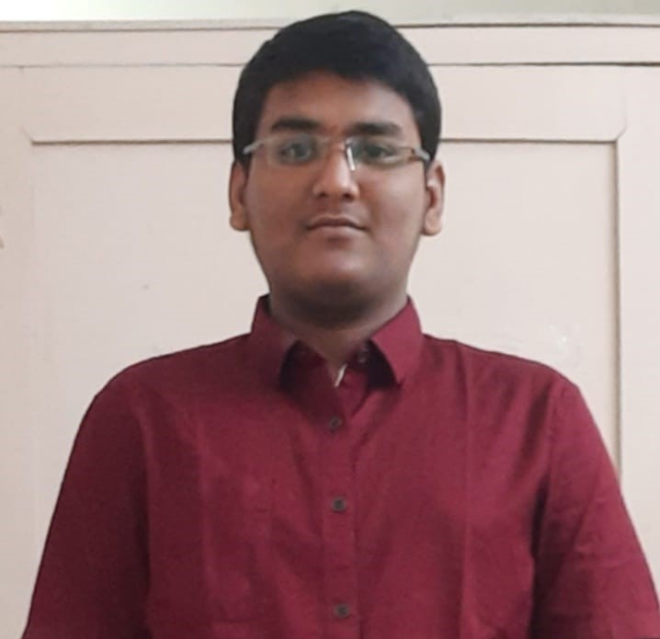
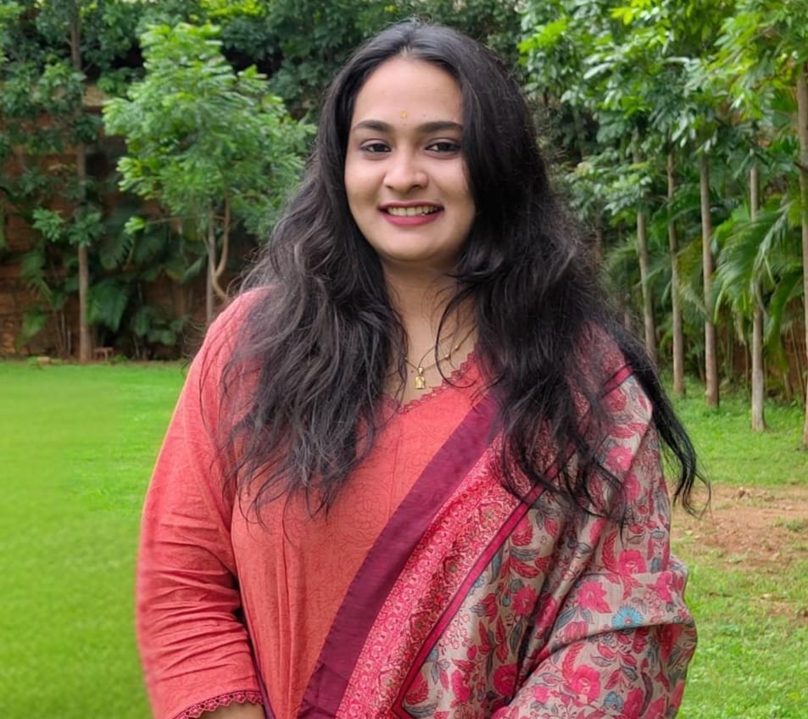
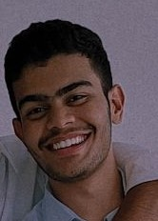
Project Group – Details
Photo
Track
Roll No
Name
EECE AI/ML
BU21EECE0100186
N Shanmuka HarshaVardhan Reddy
EECE AI/ML
BU21EECE0100295
B Thanuja
EECE AI/ML
BU21EECE0100381
S Mohammad Khwaja Moinuddin

Slide 3
Objective and Goals
Objective
To develop and optimize algorithms that improve the fusion of visible and infrared images, ensuring the preservation of critical information from both modalities in real-time applications.
To enhance the computational efficiency of conventional image fusion methods, enabling their deployment on resource-constrained devices without compromising performance.
To integrate the modified image fusion techniques seamlessly with existing real-time systems, facilitating their adoption in applications like surveillance, medical imaging, and remote sensing.
Goals
Main Goals
Multi-Resolution Details
Remote Sensing
Enhanced Visualization and Analysis
Additional Goals :
Real-time Processing
Accurate

Slide 4
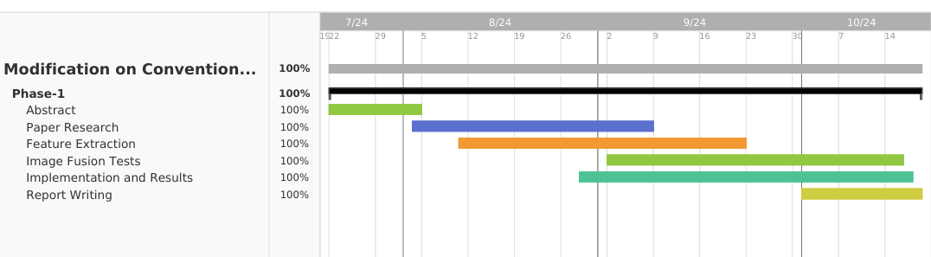
Project Plan
Gant Chart - Milestones and Activities

Slide 5
Literature Survey
Key Publications
S.No | Title | Autor | Published In | Objective
1 | A Colour-Focused Visible and Infrared Image Fusion Framework for Aiding Human Perception | Nithin Eswarappa, Shefali Waldekar, Jeevan K.M, Bikram Kumar Vivek and Koshy George | 2024 IEEE International Conference on Electronics, Computing and Communication Technologies (CONECCT) Date of Conference: 12-14 July 2024 Date Added to IEEE Xplore: 20 September 2024 | Image fusion methods are required when images from the same or different sensors are available. In several applications, photographs from a colour camera are often fused with thermal infrared (medium-wave or long-wave) images. This paper focuses on those applications (typically security and surveillance) wherein the fused images are used by a human operator who will, in turn, make critical decisions. This paper presents two frameworks for fusing colour and infrared images, one in the red-green-blue (RGB) colour space and the other in lightness-chroma-hue (LCH) colour space. We compare qualitatively and quantitatively the performance of five existing fusion methods that work best in this scenario. The study is carried out across two datasets. Quantitatively, four existing metrics are used to analyse the performance. In addition, this paper proposes a performance metric that appeals to human perception and measures how well colour, edge, and contrast information are transferred to the fused image.
2 | Infrared and visible image fusion based on domain transform filtering and sparse representation | Xilai Li , Haishu Tan, Fuqiang Zhou, Gao Wang, Xiaosong Li | June 2023, Infrared Physics & Technology Volume 131, 104701 | This paper presents a new method for combining infrared and visible images to provide clearer and more detailed images of complex scenes. The process involves breaking the images into simpler base layers and detailed layers. The detailed layers are merged using a technique that enhances important features. A special filter (DTF) is used to combine the base layers while keeping key structures and edges intact. This approach helps retain important details from both images. Tests show that the method produces better results than other existing methods, both visually and in terms of measurable quality.

Slide 6
Key Resources – Whitepaper| Application Notes | Datasheet| Others
S.No | Title | Author | Published In | Objective
1 | Image Fusion technique using Multi-resolution singular Value decomposition | V.P.S. Naidu | 5, September 2011, Defence Science Journal, Vol. 61, pp. 479-484 | A novel image fusion technique based on multi-resolution singular value decomposition (MSVD) has been presented and evaluated. The performance of this algorithm is compared with that of well known image fusion technique using wavelets. It is observed that image fusion by MSVD perform almost similar to that of wavelets. It is computationally very simple and it could be well suited for real time applications. Moreover, MSVD does not have a fixed set of basis vectors like FFT, DCT and wavelet etc. and its basis vectors depend on the data set.
Existing Implementations – Products| Opensource| GitHub etc
[LP] “The Laplacian Pyramid as a Compact Image Code”, Burt, 1983
[MST-LP]”Infrared and visible image fusion based on target-enhanced multiscale transform decomposition”, 2019

Slide 7
Analysis - SWOT
Strengths
Weaknesses
W1. Dependency on Conventional Methods
W2. Hardware Constraints
W3. Generalization Challenges
S1. Valuable Information from Infrared Imaging
S2. Enhanced Decision-Making
S3. Efficiency of Conventional Methods
Threats
T1. Competition from Advanced Techniques
T2. Security and Privacy Concerns
Opportunities
O1. Adaptation to Emerging Technologies
02. Market for Resource-Constrained Environments
O3. Government and Defense Contracts
04. Healthcare and Medical Imaging

Slide 8
Analysis – 4W1H
Why:
Image fusion combines the strengths of different imaging modalities, like visible and infrared images, into a single enhanced image:
Improved Decision Making
Enhanced Information
What:
Image fusion has found application in areas such as surveillance, medical imaging, and remote sensing, where the fusion of visible and infrared data is critical for enhanced visualization and analysis.
Where:
Surveillance and Security Systems
Medical Imaging
Remote Sensing and Environmental Monitoring
When:
Night Vision and Low-Light Conditions
Temperature Detection
How:
Enhancing visibility in low-light conditions for better monitoring and threat detection.
Combining thermal and visual data for more accurate diagnostics, especially in detecting abnormalities like tumors or inflammation.
Providing detailed data for monitoring ecosystems, detecting forest fires, or assessing agricultural health.
Refined Objective:
To enhance conventional visible and infrared image fusion methods by implementing innovative modifications that improve the quality, efficiency, and real-time applicability of fused images. The project aims to develop algorithms that effectively combine visible and infrared data, optimizing them for use in resource-constrained environments and across diverse real-world applications such as surveillance, medical imaging, and remote sensing.

Slide 9
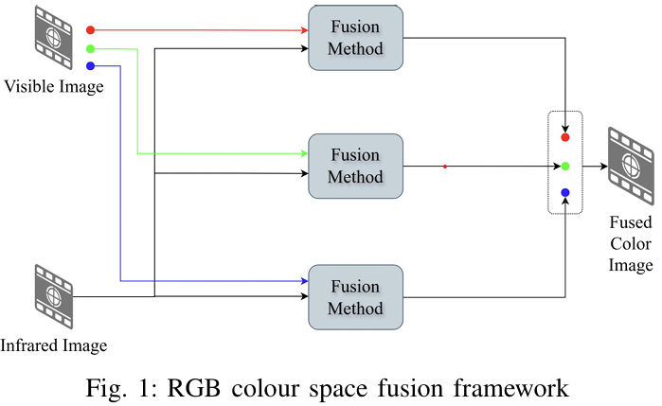
Architecture
Structural Diagram

Slide 10
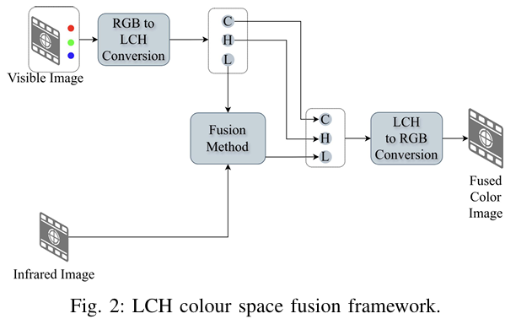

Slide 11
Use Cases & Testing
Use Cases
Surveillance and Security: Use fused visible and infrared images for enhanced security surveillance, especially in low-light or adverse weather conditions and and rescue missions, particularly in challenging environments like smoke-filled or dark areas.
Remote Sensing: Employ image fusion for obstacle detection and navigation in autonomous vehicles, ensuring better performance in diverse lighting conditions.
Medical Imaging: Integrate visible and infrared imaging for medical diagnostics, providing better detail and contrast in images for more accurate diagnoses.
Test Cases
Performance in Low Light Conditions: Test the image fusion method's effectiveness in environments with minimal visible light.
Real-Time Processing Speed: Measure the time taken for the fusion process to ensure it meets real-time application requirements.
Accuracy of Object Detection: Evaluate the accuracy of object detection algorithms using fused images compared to individual visible and infrared images.

Slide 12
Implementation and Results – Iteration 1
#Fusion
import cv2 # Import OpenCV for image processing
import numpy as np # Import NumPy for handling arrays
import matplotlib.pyplot as plt # For displaying images using Matplotlib
# Paths to the images
ir_image_path = 'D:\\PROJECT\\M3FD_Fusion(1)\\Ir\\00000.png'
visible_image_path = 'D:\\PROJECT\\M3FD_Fusion(1)\\Vis\\00000(1).png'
# Load the infrared (IR) image and the visible image
ir_image = cv2.imread(ir_image_path, cv2.IMREAD_GRAYSCALE) # Load IR image in grayscale
visible_image = cv2.imread(visible_image_path, cv2.IMREAD_COLOR) # Load visible image in RGB
# Check if both images are loaded successfully
if ir_image is None:
print(f"Error: IR image not found or unable to load from {ir_image_path}")
else:
print(f"IR image loaded successfully from {ir_image_path}")
if visible_image is None:
print(f"Error: Visible image not found or unable to load from {visible_image_path}")
else:
print(f"Visible image loaded successfully from {visible_image_path}")
# Proceed only if both images are loaded successfully
if ir_image is not None and visible_image is not None:
# Resize IR image to match visible image dimensions
ir_image_resized = cv2.resize(ir_image, (visible_image.shape[1], visible_image.shape[0]))
# Convert the IR image to a 3-channel image by duplicating the single channel
ir_image_3channel = cv2.cvtColor(ir_image_resized, cv2.COLOR_GRAY2BGR)
# Perform a simple fusion by averaging the pixel values of the IR and visible images
fused_image = cv2.addWeighted(ir_image_3channel, 0.5, visible_image, 0.5, 0) # 0.5, 0.5 are weights for the images
cv2.imwrite('fused_image.jpg', fused_image)
# Display the images using Matplotlib
plt.figure(figsize=(15, 5))
plt.subplot(1, 3, 1)
plt.title('Infrared Image')
plt.imshow(ir_image, cmap='gray')
plt.subplot(1, 3, 2)
plt.title('Visible Image')
plt.imshow(cv2.cvtColor(visible_image, cv2.COLOR_BGR2RGB))
plt.subplot(1, 3, 3)
plt.title('Fused Image')
plt.imshow(cv2.cvtColor(fused_image, cv2.COLOR_BGR2RGB))
plt.show()

Slide 13
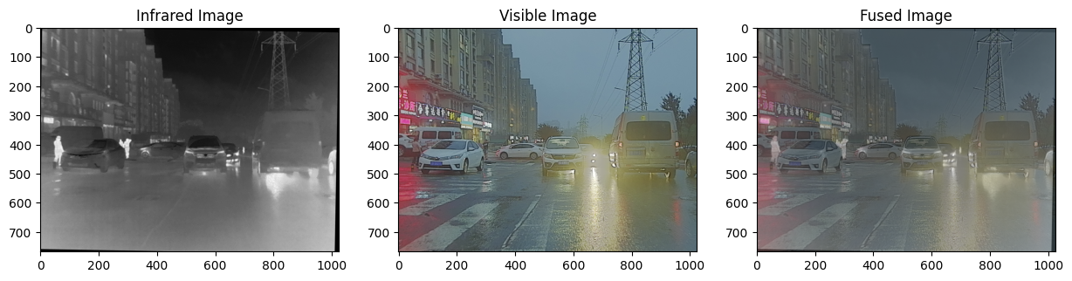
Result:

Slide 14
Implementation and Results – Iteration 2
import cv2
import matplotlib.pyplot as plt
# Load the RGB image
rgb_image_path = 'D:\\PROJECT\\M3FD_Fusion(1)\\Vis\\00000(1).png'
rgb_image = cv2.imread(rgb_image_path, cv2.IMREAD_COLOR)
# Check if the image is loaded successfully
if rgb_image is None:
print(f"Error: RGB image not found or unable to load from {rgb_image_path}")
else:
# Convert the RGB image to YCbCr color space
ycbcr_image = cv2.cvtColor(rgb_image, cv2.COLOR_BGR2YCrCb)
ycbcr_image_path = 'D:\\PROJECT\\ycbcr_image.png'
cv2.imwrite(ycbcr_image_path, ycbcr_image)
# Display the images using matplotlib
plt.figure(figsize=(10, 5))
plt.subplot(1, 2, 1)
plt.title('RGB Image')
plt.imshow(cv2.cvtColor(rgb_image, cv2.COLOR_BGR2RGB))
plt.axis('off')
plt.subplot(1, 2, 2)
plt.title('YCbCr Image')
plt.imshow(ycbcr_image)
plt.axis('off')
plt.show()

Slide 15
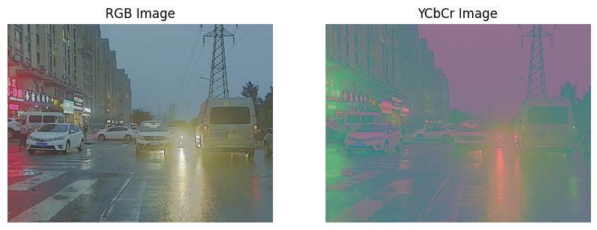
Result:

Slide 16
Implementation and Results – Iteration 3
#YCbCr Fusion
import cv2
import numpy as np
import matplotlib.pyplot as plt
# Load the infrared (IR) image and the RGB image
ir_image_path = 'D:\\PROJECT\\M3FD_Fusion(1)\\IR\\00000.png'
rgb_image_path = 'D:\\PROJECT\\M3FD_Fusion(1)\\Vis\\00000(1).png'
ir_image = cv2.imread(ir_image_path, cv2.IMREAD_GRAYSCALE)
rgb_image = cv2.imread(rgb_image_path, cv2.IMREAD_COLOR)
# Check if images are loaded successfully
if ir_image is None:
print(f"Error: Infrared image not found or unable to load from {ir_image_path}")
if rgb_image is None:
print(f"Error: RGB image not found or unable to load from {rgb_image_path}")
if ir_image is not None and rgb_image is not None:
# Convert the RGB image to YCbCr color space
ycbcr_image = cv2.cvtColor(rgb_image, cv2.COLOR_BGR2YCrCb)
# Resize the infrared image to match the Y channel size
ir_image_resized = cv2.resize(ir_image, (ycbcr_image.shape[1], ycbcr_image.shape[0]))
# Split the YCbCr image into its channels
Y, Cr, Cb = cv2.split(ycbcr_image)
# Fuse the Y channel with the infrared image using simple averaging
fused_Y = cv2.addWeighted(Y, 0.5, ir_image_resized, 0.5, 0)
# Merge the fused Y channel back with the original Cr and Cb channels
fused_ycbcr_image = cv2.merge((fused_Y, Cr, Cb))
# Convert the fused YCbCr image back to RGB color space for visualization
fused_rgb_image = cv2.cvtColor(fused_ycbcr_image, cv2.COLOR_YCrCb2BGR)
# Display the images using matplotlib
plt.figure(figsize=(15, 5))
plt.subplot(1, 3, 1)
plt.title('Infrared Image')
plt.imshow(ir_image, cmap='gray')
plt.axis('off')
plt.subplot(1, 3, 2)
plt.title('YCbCr Image')
plt.imshow(ycbcr_image)
plt.axis('off')
plt.subplot(1, 3, 3)
plt.title('Fused Image')
plt.imshow(cv2.cvtColor(fused_rgb_image, cv2.COLOR_BGR2RGB))
plt.axis('off')
plt.show()
fused_image_path = 'D:\\PROJECT\\M3FD_Fusion(1)\\fused_ycbcr_ir_image.png' # Adjust the path to save your fused image
cv2.imwrite(fused_image_path, fused_rgb_image)

Slide 17
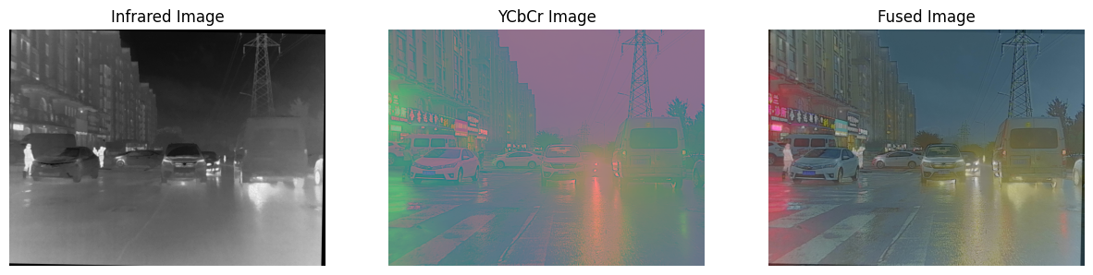
Result:

Slide 18
Implementation and Results – Iteration 4
import cv2
import numpy as np
import matplotlib.pyplot as plt
# Load the infrared (IR) image and the RGB image
ir_image_path = 'D:\\PROJECT\\M3FD_Fusion(1)\\IR\\00000.png'
rgb_image_path = 'D:\\PROJECT\\M3FD_Fusion(1)\\Vis\\00000(1).png'
# Load images
ir_image = cv2.imread(ir_image_path, cv2.IMREAD_GRAYSCALE)
rgb_image = cv2.imread(rgb_image_path, cv2.IMREAD_COLOR)
if ir_image is None:
print(f"Error: Infrared image not found or unable to load from {ir_image_path}")
if rgb_image is None:
print(f"Error: RGB image not found or unable to load from {rgb_image_path}")
if ir_image is not None and rgb_image is not None:
# Convert the RGB image to LAB color space
lab_image = cv2.cvtColor(rgb_image, cv2.COLOR_BGR2LAB)
# Resize the infrared image to match the L channel size
ir_image_resized = cv2.resize(ir_image, (lab_image.shape[1], lab_image.shape[0]))
# Split the LAB image into its channels
L, A, B = cv2.split(lab_image)

Slide 19
# Fuse the L channel with the infrared image using simple averaging
fused_L = cv2.addWeighted(L, 0.5, ir_image_resized, 0.5, 0)
# Merge the fused L channel back with the original A and B channels
fused_lab_image = cv2.merge((fused_L, A, B))
# Convert the fused LAB image back to RGB color space for visualization
fused_rgb_image = cv2.cvtColor(fused_lab_image, cv2.COLOR_LAB2BGR)
# Display the images using matplotlib
plt.figure(figsize=(15, 5))
plt.subplot(1, 3, 1)
plt.title('Infrared Image')
plt.imshow(ir_image, cmap='gray')
plt.axis('off')
plt.subplot(1, 3, 2)
plt.title('LAB Image')
plt.imshow(cv2.cvtColor(lab_image, cv2.COLOR_LAB2RGB))
plt.axis('off')
plt.subplot(1, 3, 3)
plt.title('Fused Image')
plt.imshow(cv2.cvtColor(fused_rgb_image, cv2.COLOR_BGR2RGB))
plt.axis('off')
plt.show()
fused_image_path = 'D:\\PROJECT\\M3FD_Fusion(1)\\fused_lab_ir_image.png'
cv2.imwrite(fused_image_path, fused_rgb_image)

Slide 20
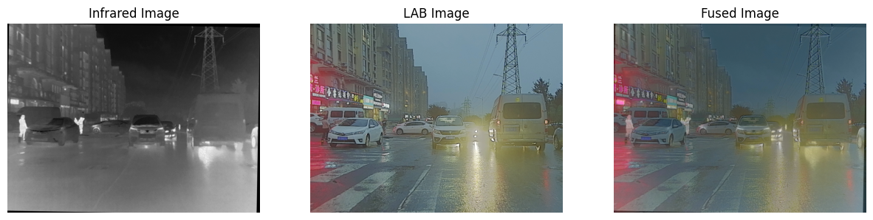
Result:

Slide 21
Contribution
Team Progress and Movement
Implementing image fusion algorithm
Data Preprocessing
Image Fusion Tests
Feature Extraction
Coding
Report Writing
Documentation
Individual Contribution
Key contributions: N.Shanmuka Harshavardhan Reddy
Preprocessing
Literature Review
Documentation
Visualization and Presentation
Key contributions: B.Thanuja
Experimental Setup
Testing Datasets
Result Analysis
Report Writing
Key contributions: S.Mohammad Khwaja Moinuddin
Optimization for Real-Time
Coding
Paper Research
Feature Extraction

Slide 22
Conclusion & Future Work
Future Work
Summary and Conclusion
The project successfully explores modifications to conventional image fusion methods for visible and infrared images, focusing on real-time applications. By combining the strengths of both imaging modalities, the project enhances decision-making and information processing in areas like surveillance, medical imaging, and remote sensing. The modified methods address the limitations of deep learning approaches, such as requiring prior knowledge and difficulties with generalization, making them more suitable for existing hardware and real-time scenarios. The proposed solutions improve the quality and efficiency of fused images, providing better visualization and analysis without compromising speed, which is critical in resource-constrained environments​
In future work, the implementation of the modified image fusion methods on the NVIDIA Jetson Nano platform will be explored to leverage its computational capabilities for real-time applications. Detailed measurements of computational time will be conducted to assess the performance of the fusion algorithms. Strategies to optimize and improve the computational efficiency will be investigated to ensure the methods meet real-time processing requirements. This includes fine-tuning algorithm parameters and possibly incorporating hardware acceleration techniques to further enhance processing speed and overall system performance.

Slide 23
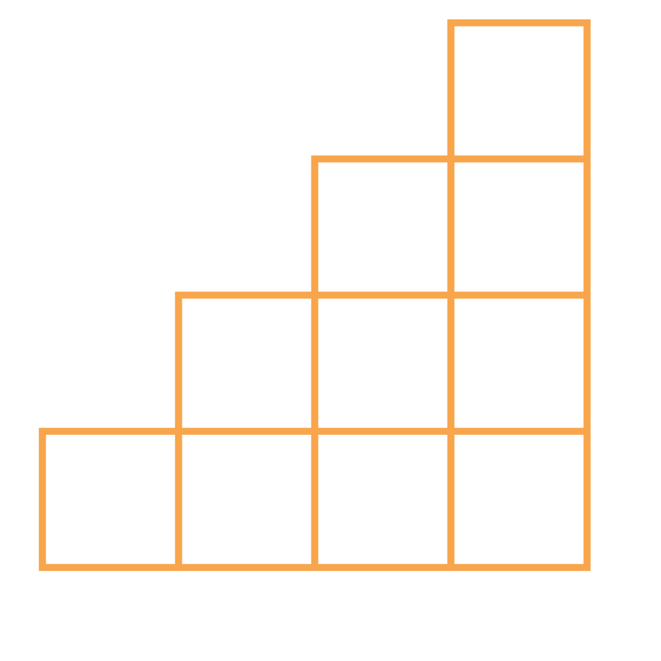
THANK YOU

